Slide 1
Unit -3 Information Security Policies
CSE3501 Information Security Analysis and Audit
Dr.S.Geetha
Professor
School of Computer Science & Engineering
VIT University, Chennai Campus
geetha.s@vit.ac.in

Slide 2
Outline
Information Security Policies
Key Elements of a Security Policy
Security Standards, Guidelines and Framework
Laws, Regulations and Guidelines

Slide 3
What is Security Policy?
Security policies are the foundation of security infrastructure.
Without them, you cannot protect your company from
possible lawsuits
lost revenue
bad publicity
basic security attacks
A security policy is a document or set of documents that describes, at a high level, the security controls that will be implemented by the company.

Slide 4
Purpose of Security Policies
Policies are not technology specific and they do:
Reduce or eliminate legal liability to employees and third parties.
Protect confidential, proprietary information from theft, misuse, unauthorized disclosure or modification.
Prevent waste of company computing resources.
Organisations are giving more priority to development of information security policies, protecting
Protecting their assets is one of the prominent things that needs to be considered.
Lack of clarity in InfoSec policies can lead to catastrophic damages which cannot be recovered.
So an organisation makes different strategies in implementing a security policy successfully.
An information security policy provides management direction and support for information security across the organisation.

Slide 5
Security Policies
Types of Security Policies
Technical security policies -- how technology should be configured and used.
Administrative security policies -- how people (both end users and management) should behave/ respond to security.
Persons responsible for the implementation of the security policies are:
Director of Information Security
Chief Security Officer
Director of Information Technology
Chief Information Officer
Information Category:
Physical – Hard Copy, Digital → CIA for both of these→ essential
Proper security measures need to be implemented to control and secure information from unauthorised changes, deletions and disclosures.
To find the level of security measures that need to be applied, a risk assessment is mandatory.

Slide 6
Why Security Policies– What do they do?
To define what is expected from employees within an organisation with respect to information systems.
to guide or control the use of systems to reduce the risk to information assets
gives the staff who are dealing with information systems an acceptable use policy – what is allowed and not.
to protect assets
All companies sec policies are not same. Tailored to specific Goals/Mission of the company

Slide 7
A security policy should determine rules and regulations for the following systems:
Encryption mechanisms
Access control devices
Authentication systems
Firewalls
Anti-virus systems
Websites
Gateways
Routers and switches
Necessity of a security policy

Slide 8
Importance of Security Policies
plan that provides for the consistent application of security principles throughout your company. After implementation, it becomes a reference guide when matters of security arise.
indicates senior management’s commitment to maintain a secure network, which allows the IT staff to do a more effective job of securing the company’s information assets
reduce the risk of a damaging security incident. In the event of a security incident, certain policies, such as an Incident Response Policy may limit your company’s exposure and reduce the scope of the incident.
provide legal protection to your company reducing your liability and exposure in the event of an incident

Slide 9
Importance of Security Policies
provides a written record of your company’s policies if there is ever a question about what is and is not an approved act
required by third parties that do business with your company as part of their due diligence process. auditors, customers, part ners andinvestors
to fulfill regulations and meet standards that relate to security of digital information

Slide 10
Security Policies -- Practice
Once the security policy is implemented, it will be a part of day-to-day business activities.
Security policies that are implemented need to be reviewed whenever there is an organizational change.
Policies can be monitored by depending on any monitoring solutions like SIEM
violation of security policies can be seriously dealt with.
There should also be a mechanism to report any violations to the policy.

Slide 11
Points to keep in Mind while designing Sec Policies
Security Policies
Simple policies
Can be modified at a later time
based upon the environmental changes
updates also need to be communicated with all employees
Management is responsible for establishing controls regularly review the status of controls

Slide 12
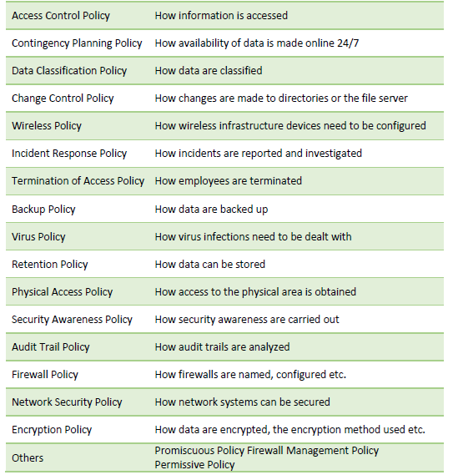
A Sample Security Policy

Slide 13
Acceptable Usage Policy
Acceptable Usage Policy (AUP) is the policy that one should adhere to while accessing the network.
Some of the assets that this policy covers are mobile, wireless, desktop, laptop and tablet computers, email, servers, internet etc.
For each asset, we need to look at how we can protect it, manage it, authorised persons to use and administer the asset, accepted methods of communication in these assets etc.
A template for AUP is published in SANS http://www.sans.org/securityresources/ policies/Acceptable_Use_Policy.pdf and a security analyst will get an idea of how an AUP actually looks.
Some of the regulatory compliances mandate that a user should accept the AUP before getting access to network devices. Implementing these controls makes the organization a bit more risk free, even though it is very costly.

Slide 14
Some of the laws, regulation and standards used for policy definition include:
The PCI Data Security Standard (PCIDSS)
The Health Insurance Portability and Accountability Act (HIPAA)
The Sarbanes-Oxley Act (SOX)
The ISO family of security standards
The Graham-Leach-Bliley Act (GLBA)

Slide 15
Key Elements of Security Policy
A policy should contain:
• Overview – background information of what issue the policy addresses.
• Purpose – why the policy is created.
• Scope – what areas this policy covers.
• Targeted audience – whom the policy is applicable for.
• Policy – a detailed description of the policy.
• Definitions – a brief introduction of the technical jargon used in the policy.
• Version – number to control the changes made to the document.

Slide 16
Policy Content Design Guidelines
A security policy should be no longer than absolutely necessary. Some believe that policies are more impressive when they fill enormous binders or contain hundreds or even thousands of policies. These types of policies overwhelm you with data, and are frequently advertised on the internet. But quantity does not equal quality, and it is the sheer amount of information in those policies that makes them useless. Brevity is of utmost importance.
A security policy should be written in “plain English.” While, by nature, technical topics will be covered, it is important that the policy be clear and understood by the target audience for that particular policy. There is never room for “consultant speak” in a security policy. If there is a doubt, the policy should be written so that more people can understand it rather than fewer. Clarity must be a priority in security policies so that a policy isn’t misunderstood during a crisis or otherwise misapplied, which could lead to a critical vulnerability.

Slide 17
Policy Content Design Guidelines
A security policy must be consistent with applicable laws and regulations. In some countries there are laws that apply to a company’s security practices, such as those covering the use of encryption. Some states have specific disclosure laws or regulations governing the protection of citizens’ personal information, and some industries have regulations governing security policies. It is recommended that you research and become familiar with any regulations or standards that apply to your company’s security controls.
A security policy should be reasonable. The point of this process is to create a policy that you can actually use rather than one that makes your company secure on paper but is impossible to implement. Keep in mind that the more secure a policy is, the greater the burden it places on your users and IT staff to comply with. Find a middle ground in the balance between security and usability that will work for you.

Slide 18
Policy Content Design Guidelines
A security policy must be enforceable. A policy should clearly state which actions are permitted and which of those are in violation of the policy. Further, the policy should spell out enforcement options when non-compliance or violations are discovered, and must be consistent with applicable laws. A security policy can be formatted to be consistent with your company’s internal documentation, however certain information should be placed on each page of the policy. At a minimum, this information should include: policy name, creation date, target audience and a clear designation that the policy is company confidential.

Slide 19
Security Policy Implementation
People Support
Senior Management Support
Facilty Support
Tools are in place for implementation
Auditing
3months to 1 year period, regularly audited
Department Heads
HR, Legal
Information Security Office Post
Documented
Eg., network Monitoring tools enabled
Practical
BackUp Policy
Security Incident Response List
User Awareness, Signed Agreement through HR
Policy followed and appropriate still
Any revisions -- documented

Slide 20
Security Standards, Guidelines and Frameworks
Security Governance Framework:
represent solutions to the question of how to manage security effectively.
The manner in which a company builds a governance structure is a reflection of the organization of the company and the laws and business environment in which it finds itself.
Auditing the security governance practices of a company compared against such recognized governance frameworks.
Helps the auditor -- to identify best practices in building a manageable, measurable and effective security governance program.
Three of the most frequently found frameworks,:
COSO
COBIT
ITIL

Slide 21
COSO – Internal Controls Framework
internal accounting controls to monitor fraud and abuse and test them through compliance auditing
Committee of Sponsoring Organizations of the Treadway Commission (COSO) was formed in 1985
Few main concepts in COSO Framework:
Internal control is a process and not a one-time activity.
Internal control is affected by people; it must be adopted through the organization and is not simply a policy document that gets filed away.
An internal control can provide only reasonable assurance, not absolute assurance to the management and board of a business. A control cannot ensure success.
Internal controls are designed for the achievement of business objectives.

Slide 22
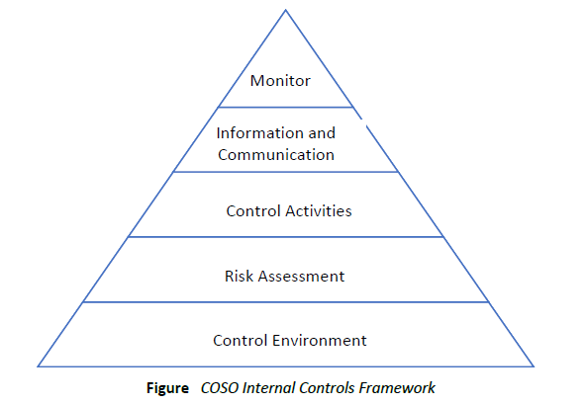
COSO – Internal Controls Framework
https://www.youtube.com/watch?v=oidE3iEX2aA
https://www.youtube.com/watch?v=G0BLm23jJ-s

Slide 23
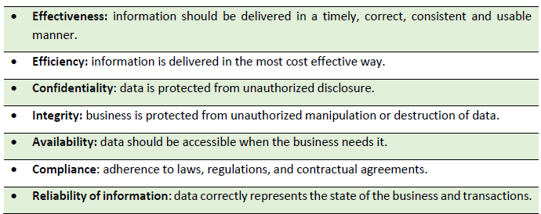
COBIT
Information Systems Audit and Control Association (ISACA) and IT Governance Institute (ITGI)
Series of manuals and implementation guidelines for creating a full IT governance, auditing and service delivery program for any organization.
Augmentation to COSO– IT Angle
Leading IT governance framework- how to bridge the gap between business and IT goals
seven control areas as business requirements for information:

Slide 24
COBIT
Resource
Applications
Information
Infrastructure
People

Slide 25
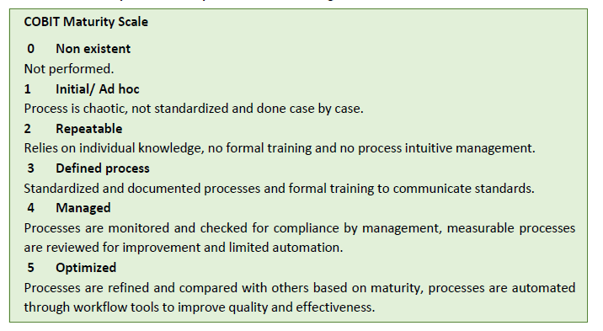
COBIT
https://www.youtube.com/watch?v=accatUbftxg
https://www.youtube.com/watch?v=Y8kqh9q3Jwg
https://www.youtube.com/watch?v=Zq5ZHIPs3TI
COBIT Maturity Model Scale

Slide 26
ITIL
Information Technology Infrastructure Library (ITIL)
https://www.youtube.com/watch?v=vp2wfoVRMDE
https://www.youtube.com/watch?v=J9K5BF_3y5s
https://www.youtube.com/watch?v=crvMqsdGE1g&t=29s
Service
Strategy
Design
Transition
Operation
Continuous Improvement

Slide 27
ITIL
primarily about delivering IT as a service and the lifecycle of service development, implementation, operation and management.
Companies -- overall management of IT, for managing security processes.
ITIL also works well with COBIT as a means for fleshing out the service delivery of each process.
ITIL also meets the criteria for ISO 20000, which means that it can be used to achieve international certification.
Whether a company chooses to go for certification or not, ITIL gives guidance about how to move from a reactive to a proactive approach to managing IT and security as a service.

Slide 28
Standards, Procedures and Guidelines
Knowing what processes and controls need to be in place
Implementing the technology and procedures that allow the control to work as intended
Auditors – Best References for Best and Worst architectures
ISO
NIST
NSA
DISA
SANS
ISACA
IEEE

Slide 29
Policy Content Design Guidelines
A security policy must be enforceable. A policy should clearly state which actions are permitted and which of those are in violation of the policy. Further, the policy should spell out enforcement options when non-compliance or violations are discovered, and must be consistent with applicable laws. A security policy can be formatted to be consistent with your company’s internal documentation, however certain information should be placed on each page of the policy. At a minimum, this information should include: policy name, creation date, target audience and a clear designation that the policy is company confidential.

Slide 30
Policy Content Design Guidelines
A security policy must be enforceable. A policy should clearly state which actions are permitted and which of those are in violation of the policy. Further, the policy should spell out enforcement options when non-compliance or violations are discovered, and must be consistent with applicable laws. A security policy can be formatted to be consistent with your company’s internal documentation, however certain information should be placed on each page of the policy. At a minimum, this information should include: policy name, creation date, target audience and a clear designation that the policy is company confidential.

